Slide 1

Undecidability
Sections 21.1 – 21.3

Slide 2
Problems / Languages
The Problem View | The Language View
Does TM M halt on w? | H = {<M, w> : M halts on w}
Does TM M not halt on w? | ¬H = {<M, w> : M does not halt on w}
Does TM M halt on the empty tape? | H_{ε} = {<M> : M halts on ε}
Is there any string on which TM M halts? | H_{ANY} = {<M> : there exists at least one string on which TM M halts }
Does TM M accept all strings? | A_{ALL} = {<M> : L(M) = Σ*}
Do TMs M_{a} and M_{b} accept the same languages? | EqTMs = {<M_{a}, M_{b}> : L(M_{a}) = L(M_{b})}
Is the language that TM M accepts regular? | TMreg = {<M>:L(M) is regular}

Slide 3
Reduction
Example: Computing a function
multiply(x, y) =
1. answer := 0.
2. For i := 1 to y do:
answer = sum(answer + x).
3. Return answer.
Computing multiply reduces to computing sum.
or
If we can do sum then we can do multiply.

Slide 4
Using Reduction for Undecidability
Theorem: There exists no general procedure to solve the following
problem:
Given an angle A, divide A into sixths using only a straightedge and a compass.
Proof: Suppose that there were such a procedure, which we’ll call
sixth. Then we could trisect an arbitrary angle:
trisect(a: angle) =
1. Divide a into six equal parts by invoking sixth(a).
2. Ignore every other line, thus dividing a into thirds.
trisect(a)
sixth(a) ignore lines
sixth exists → trisect exists.
But we know that trisect does not exist. So, sixth cannot exist either.

Slide 5
Turing Reduction
A reduction R from L₁ to L₂ is one or more Turing
machines such that:
If there exists a Turing machine Oracle that decides (or
semidecides) L₂, then the Turing machines in R can be
composed with Oracle to build a deciding (or a
semideciding) Turing machine for L₁.
L₁ ≤ L₂ means that L₁ is reducible to L₂.

Slide 6
Using Reduction for Undecidability
Assume:
(L₁ ≤ L₂ ) ∧ (L₂ is in D) → (L₁ is in D)
If (L₁ is in D) is false, then at least one of the two antecedents of that implication must be false. So:
If (L₁ ≤ L₂) is true,
then (L₂ is in D) must be false.

Slide 7
Using Reduction for Undecidability
Showing that L₂ is not in D:
L₁ (known not to be in D) L₁ in D But L₁ not in D
R
L₂ (a new language whose if L₂ in D So L₂ not in D
decidability we are
trying to determine)

Slide 8
To Use Reduction for Undecidability
0. Assume Oracle that decides L₂ exists
1. Choose a language L₁:
  ● that is already known not to be in D, and
  ● that can be reduced to L₂.
2. Define the reduction R.
3. Describe the composition C of R with Oracle:
C(x) = Oracle(R(x))
4. Show that C does correctly decide L₁ if Oracle exists. We
do this by showing:
● R can be implemented by Turing machines,
● C is correct:
● If x ∈ L₁, then C(x) accepts, and
● If x ∉ L₁, then C(x) rejects.

Slide 9
Mapping Reductions
L₁ is mapping reducible to L₂ (L₁ ≤_{M} L₂) iff there exists
some computable function f such that:
∀x∈Σ* (x ∈ L₁ ↔ f(x) ∈ L₂).
To decide whether x is in L₁, we transform it, using f,
into a new object and ask whether that object is in L₂.
Note: mapping reduction is a particular case of Turing reduction.

Slide 10
H_{ε} = {<M> : TM M halts on ε}
H_{ε} is in SD. T semidecides it:
T(<M>) =
1. Run M on ε.
2. Accept.
T accepts <M> iff M halts on ε, so T semidecides H_{ε}.

Slide 11
H_{ε} = {<M> : TM M halts on ε}
Theorem: H_{ε} = {<M> : TM M halts on ε} is not in D.
Proof: by reduction from H:
H = {<M, w> : TM M halts on input string w}
R
(?Oracle) H_{ε} = {<M> : TM M halts on ε}
R is a mapping reduction from H to H_{ε}:
R(<M, w>) =
1. Construct <M#>, where M#(x) operates as follows:
  1.1. Erase the tape (ignore its input)
  1.2. Write w on the tape.
  1.3. Run M on w.
2. Return <M#>.

Slide 12
Proof, Continued
R(<M, w>) =
1. Construct <M#>, where M#(x) operates as follows:
  1.1. Erase the tape.
  1.2. Write w on the tape.
  1.3. Run M on w.
2. Return <M#>.
If Oracle exists, C = Oracle(R(<M, w>)) decides H:
● C is correct: M# ignores its own input. It halts on everything or
nothing. So:
● <M, w> ∈ H: M halts on w, so M# halts on everything. In
particular, it halts on ε. Oracle accepts.
● <M, w> ∉ H: M does not halt on w, so M# halts on nothing and
thus not on ε. Oracle rejects.

Slide 13
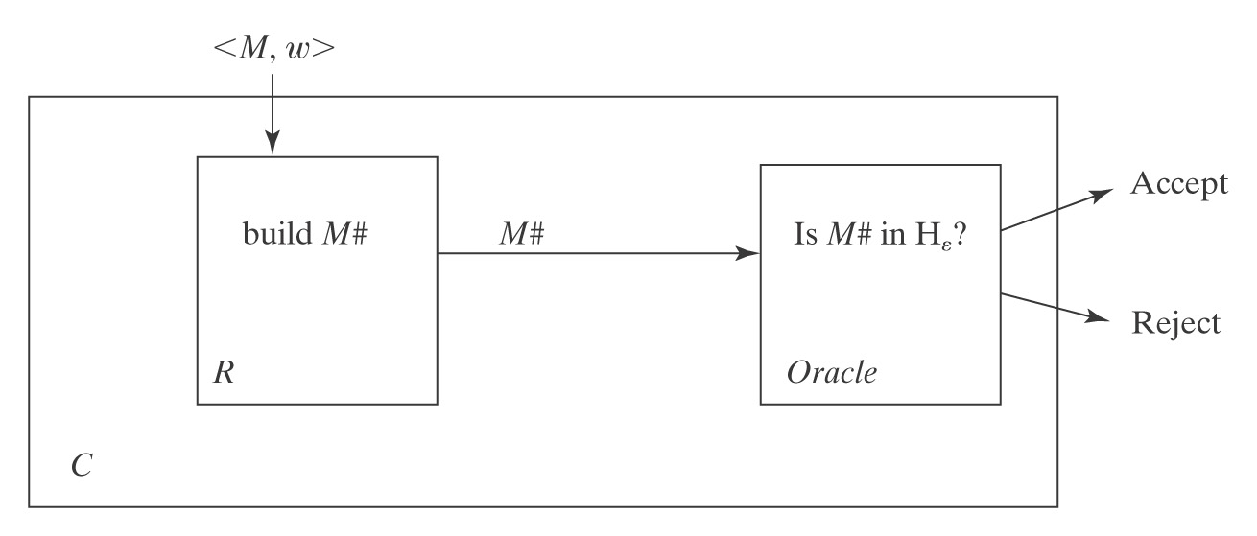
A Block Diagram of C

Slide 14
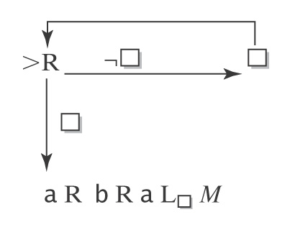
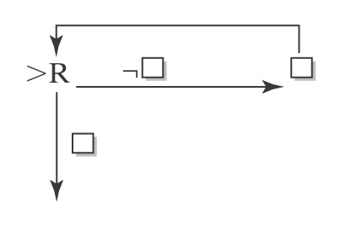
R Can Be Implemented as a Turing Machine
R must construct <M#> from <M, w>. Suppose w = aba.
M# will be:
So the procedure for constructing M# is:
1. Write:
2. For each character x in w do:
  2.1. Write x.
  2.2. If x is not the last character in w, write R.
3. Write L M.

Slide 15
Conclusion
R can be implemented as a Turing machine.
C is correct.
So, if Oracle exists:
C = Oracle(R(<M, w>)) decides H.
But no machine to decide H can exist.
So neither does Oracle.

Slide 16
This Result is Somewhat Surprising
If we could decide whether M halts on the specific string ε, we
could solve the more general problem of deciding whether M
halts on an arbitrary input.
Clearly, the other way around is true: If we could solve H we
could decide whether M halts on any one particular string.
But doing a reduction in that direction would tell us nothing
about whether H_{ε} was decidable.
The significant thing that we just saw in this proof is that there
also exists a reduction in the direction that does tell us that H_{ε} is
not decidable.

Slide 17
Important Elements in a Reduction Proof
A clear declaration of the reduction “from” and “to” languages.
A clear description of R.
If R is doing anything nontrivial, argue that it can be implemented as a TM.
Run through the logic that demonstrates how the “from” language is being decided by the composition of R and Oracle. You must do both accepting and rejecting cases.
Declare that the reduction proves that your “to” language is not in D.

Slide 18
The Most Common Mistake:
Doing the Reduction Backwards
Right way: to show that L₂ is not in D:
Reduce a known hard one, L_{1,} to L₂: L₁ L₂
Given that L₁ is not in D,
Reduce L₁ to L₂, i.e., show how to solve L₁
(the known one) in terms of L₂ (the unknown one)
Wrong way: reduce L₂ (the unknown one) to L₁ (the known hard):
Example (wrong):
If there exists a machine M_{H} that solves H, then we could build a
machine that solves H_{ε} as follows:
1. Return (M_{H}(<M, ε>)).
This proves nothing. It’s an argument of the form:
If False then …

Slide 19
H_{ANY} = {<M> : there exists at least one string on which TM M halts}
Theorem: H_{ANY} is in SD.
Proof: by exhibiting a TM T that semidecides it.
What about simply trying all the strings in Σ* one at a time
until one halts?

Slide 20
H_{ANY} is in SD
T(<M>) =
1. Use dovetailing to try M on all of the elements of Σ*:
ε [1]
ε [2] a [1]
ε [3] a [2] b [1]
ε [4] a [3] b [2] aa [1]
ε [5] a [4] b [3] aa [2] ab [1]
2. If any instance of M halts, halt and accept.
T will accept iff M halts on at least one string. So T
semidecides H_{ANY.}

Slide 21
H_{ANY} is not in D
H = {<M, w> : TM M halts on input string w}
R
(?Oracle) H_{ANY} = {<M> : there exists at least one string on which TM M halts}
R(<M, w>) =
1. Construct <M#>, where M#(x) operates as follows:
  1.1. Examine x.
  1.2. If x = w, run M on w, else loop.
2. Return <M#>.
If Oracle exists, then C = Oracle(R(<M, w>)) decides H:
● R can be implemented as a Turing machine.
● C is correct: The only string on which M# can halt is w. So:
● <M, w> ∈ H: M halts on w. So M# halts on w. There exists at least one
string on which M# halts. Oracle accepts.
● <M, w> ∉ H: M does not halt on w, so neither does M#. So there exists
no string on which M# halts. Oracle rejects.
But no machine to decide H can exist, so neither does Oracle.

Slide 22
H_{ANY} is not in D: another reduction
Proof: We show that H_{ANY} is not in D by reduction from H:
H = {<M, w> : TM M halts on input string w}
R
(?Oracle) H_{ANY} = {<M> : there exists at least one string on which TM M halts}
R(<M, w>) =
1. Construct the description <M#>, where M#(x) operates as follows:
  1.1. Erase the tape.
  1.2. Write w on the tape.
  1.3. Run M on w.
2. Return <M#>.
If Oracle exists, then C = Oracle(R(<M, w>)) decides H:
● C is correct: M# ignores its own input. It halts on everything or nothing. So:
● <M, w> ∈ H: M halts on w, so M# halts on everything. So it halts on at
least one string. Oracle accepts.
● <M, w> ∉ H: M does not halt on w, so M# halts on nothing. So it does not
halt on at least one string. Oracle rejects.
But no machine to decide H can exist, so neither does Oracle.

Slide 23
The Steps in a Reduction Proof
Assume Oracle exists.
Choose an undecidable language to reduce from.
Define the reduction R.
Show that C (the composition of R with Oracle) is correct.

Slide 24
H_{ALL} = {<M> : TM M halts on all inputs}
We show that H_{ALL} is not in D by reduction from H_{ε}.
H_{ε} = {<M> : TM M halts on ε}
R
(?Oracle) H_{ALL} = {<M> : TM M halts on all inputs }
R(<M>) =
1. Construct the description <M#>, where M#(x) operates as follows:
  1.1. Erase the tape.
  1.2. Run M.
2. Return <M#>.
If Oracle exists, then C = Oracle(R(<M>)) decides H_{ε}:
● R can be implemented as a Turing machine.
● C is correct: M# halts on everything or nothing, depending on whether M
halts on ε. So:
● <M> ∈ H_{ε}: M halts on ε, so M# halts on all inputs. Oracle accepts.
● <M> ∉ H_{ε}: M does not halt on ε, so M# halts on nothing. Oracle rejects.
But no machine to decide H_{ε} can exist, so neither does Oracle.

Slide 25
The Membership Question for TMs
We next define a new language:
A = {<M, w> : M accepts w}.
Note that A is different from H since it is possible that M
halts but does not accept. An alternative definition of A is:
A = {<M, w> : w ∈ L(M)}.

Slide 26
A = {<M, w> : w ∈ L(M)}
We show that A is not in D by reduction from H.
H = {<M, w> : TM M halts on input string w}
R
(?Oracle) A = {<M, w > : w ∈ L(M) }
R(<M, w>) =
1. Construct the description <M#>, where M#(x) operates as follows:
  1.1. Erase the tape.
  1.2. Write w on the tape.
  1.3. Run M on w.
  1.4. Accept
2. Return <M#, w>.
If Oracle exists, then C = Oracle(R(<M, w>)) decides H:
● R can be implemented as a Turing machine.
● C is correct: M# accepts everything or nothing. So:
● <M, w> ∈ H: M halts on w, so M# accepts everything. In particular, it
accepts w. Oracle accepts.
● <M, w > ∉ H: M does not halt on w. M# gets stuck in step 1.3 and so
accepts nothing. Oracle rejects.
But no machine to decide H can exist, so neither does Oracle.

Slide 27
A_{ε}, A_{ANY}, and A_{ALL}
Theorem: A_{ε} = {<M> : TM M accepts ε} is not in D.
Proof: Analogous to that for H_{ε}.
Theorem: A_{ANY} = {<M> :TM M accepts at least one string} is not in D.
Proof: Analogous to that for H_{ANY}.
Theorem: A_{ALL} = {<M> : L(M) = Σ*} is not in D.
Proof: Analogous to that for H_{ALL}.

Slide 28
EqTMs={<M_{a}, M_{b}>: L(M_{a})=L(M_{b})}
A_{ALL} = {<M> : L(M) = Σ*}
R
(Oracle) EqTMs = {<M_{a}, M_{b}>: L(M_{a}) = L(M_{b})}
R(<M>) =
1. Construct the description of M#(x):
  1.1. Accept. (M# accepts everything)
2. Return <M, M#>.
If Oracle exists, then C = Oracle(R(<M>)) decides A_{ALL}:
● C is correct: M# accepts everything. So if L(M) = L(M#), M must also accept everything. So:
● <M> ∈ A_{ALL}: L(M) = L(M#). Oracle accepts.
● <M> ∉ A_{ALL}: L(M) ≠ L(M#). Oracle rejects.
But no machine to decide A_{ALL} can exist, so neither does Oracle.

Slide 29
Sometimes Mapping Reducibility Isn’t Right
Recall that a mapping reduction from L₁ to L₂ is a computable function f where:
∀x∈Σ* (x ∈ L₁ ↔ f(x) ∈ L₂).
When we use a mapping reduction, we return:
Oracle(f(x))
Sometimes we need a more general ability to use Oracle
as a subroutine and then to do other computations after it
returns.

Slide 30
{<M> : M accepts no even length strings}
H = {< M, w> : TM M halts on input string w}
R
(?Oracle) L₂ = {<M> : M accepts no even length strings}
R(<M, w>) =
1. Construct the description <M#>, where M#(x) operates as follows:
  1.1. Erase the tape.
  1.2. Write w on the tape.
  1.3. Run M on w.
  1.4. Accept.
2. Return <M#>.
If Oracle exists, then C = Oracle(R(<M, w>)) decides H:
● C is correct: M# ignores its own input. It accepts everything or nothing,
depending on whether it makes it to step 1.4. So:
● <M, w> ∈ H: M halts on w. Oracle:
● <M, w> ∉ H: M does not halt on w. Oracle:
Problem:

Slide 31
{<M> : M accepts no even length strings}
H = {< M, w> : TM M halts on input string w}
R
(?Oracle) L₂ = {<M> : M accepts no even length strings}
R(<M, w>) =
1. Construct the description <M#>, where M#(x) operates as follows:
1.1. Erase the tape.
1.2. Write w on the tape.
  1.3. Run M on w.
  1.4. Accept.
2. Return <M#>.
If Oracle exists, then C = ¬Oracle(R(<M, w>)) decides H:
● R and ¬ can be implemented as Turing machines.
● C is correct:
● <M, w> ∈ H: M halts on w. M# accepts everything, including some
even length strings. Oracle rejects so C accepts.
● <M, w> ∉ H: M does not halt on w. M# gets stuck. So it accepts
nothing, so no even length strings. Oracle accepts. So C rejects.
But no machine to decide H can exist, so neither does Oracle.

Slide 32
Are All Questions about TMs Undecidable?
L = {<M> : TM M contains an even number of states}
L = {<M, w> : M halts on w within 3 steps}.
L_{q} = {<M, q> : there is some configuration (p, uav) of M, with p ≠ q, that yields a configuration whose state is q}.

